Slide 1
Sequence Alignment

Slide 2
Why
Sequence analysis tools depending on pairwise comparison
Multiple alignments
Profile and protein family
3D protein structure prediction
Phylogenetic analysis
Construction of certain substitution matrices
Similarity searches in a database

Slide 3
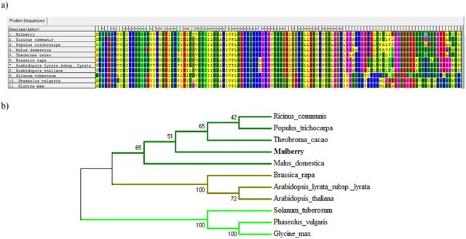
Phylogeny

Slide 4
Most likely, every bioinformatics problem starts with sequence alignment.

Slide 5
Some Concepts
Identity
Proportion of pairs of identical residues between two aligned sequences. Generally expressed as a percentage. This value strongly depends on how the two sequences are aligned.
Similarity
Proportion of pairs of similar residues between two aligned sequences. If two residues are similar is determined by a substitution matrix. This value also depends strongly on how the two sequences are aligned, as well as on the substitution matrix used.
Homology
Two sequences are homologous if and only if they have a common ancestor.
Other
Paralog, homeolog

Slide 6
Alignment
Alignement types
Global Alignment between the complete sequence A and the complete sequence B
Local Alignment between a sub-sequence of A an a subsequence of B
Computer implementation (Algorithms)
Dynamic programing
Global Needleman-Wunsch
Local Smith-Waterman

Slide 7
Example
S = CTGTCGCTGCACG
T = TGCCGTG
Global alignment
Local alignment
CTGTCG-CTGCACG
-TGC-CG-TG----
CTGTCGCTGCACG--
-------TGC-CGTG
3

Slide 8
An example of aligning text strings
Raw Data T C A T G C A T T G
2 matches, 0 gaps
T C A T G | | C A T T G
3 matches (2 end gaps)
T C A T G . | | | . C A T T G
4 matches, 1 insertion
T C A - T G | | | | . C A T T G
4 matches, 1 insertion
T C A T - G | | | | . C A T T G

Slide 9
Smith-Waterman
Create a table of size (m+1)x(n+1) for sequences s and t of lengths m and n,
Fill table entries (1,1:m+1) and (1:n+1,1) with zeros.
Starting from the top left, compute each entry using the recursive relation:
Perform the trace-back procedure from the maximum element in the table to the first zero element on the trace-back path.

Slide 10
Substitution Matrix
- A G C T
A 10 -1 -3 -4
G -1 7 -5 -3
C -3 -5 9 0
T -4 -3 0 8

Slide 11
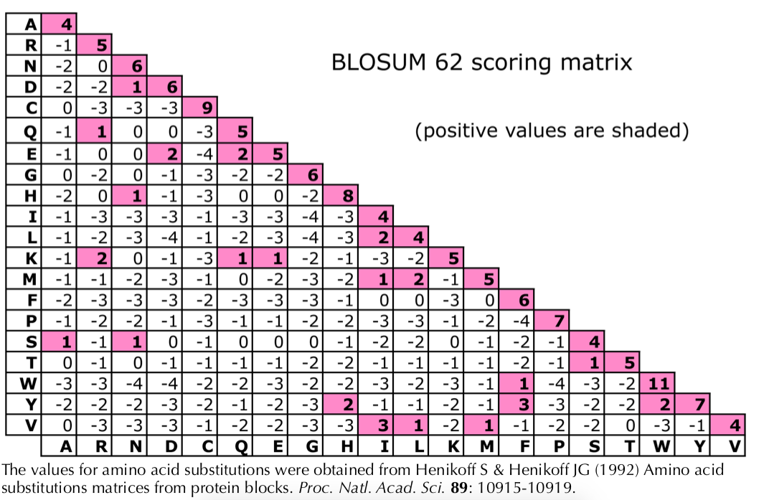
BLOSUM62

Slide 12
BLAST
http://www.ccg.unam.mx/~vinuesa/tlem/pdfs/Bioinformatics_explained_BLAST.pdf

Slide 13
Practice

